Slide 1
Agenda – 9/2
Welcome and follow-up from last week
MSDNAA / DreamSpark
Items due next week (Quiz and Assignment)
Lecture: Chapter 2 (Panko) – Network Standards
Wireshark Demo

Slide 2

Network Standards
Chapter 2

Slide 3
Chapter 2: Network Standards
Definitions and concepts
Message ordering and reliability
Semantics and syntax
Encoding application messages
Vertical communication on the source host
Standards architectures
Notes:
We’ll begin by talking about some standards definitions and standards concepts.

Slide 4

Standards
Standards allow different systems to work together.
The terms “standard” and “protocol” mean the same thing.
Standardized
Communication
A
B
Notes:
Just read the text.
Then show the diagram.

Slide 5
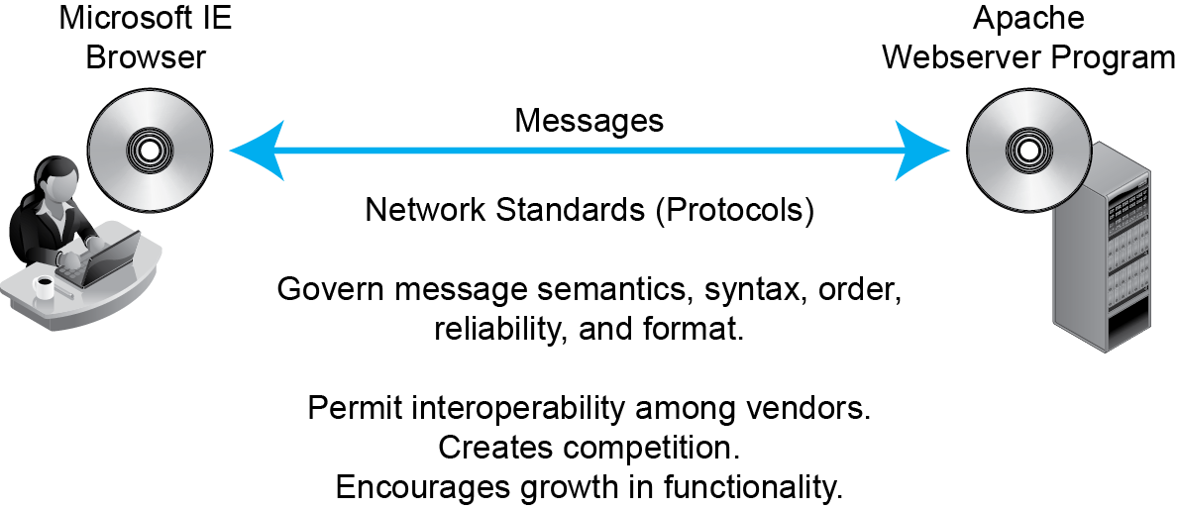
2.1: Network Standards
Notes:
Just to through the figure from top to bottom.

Slide 6
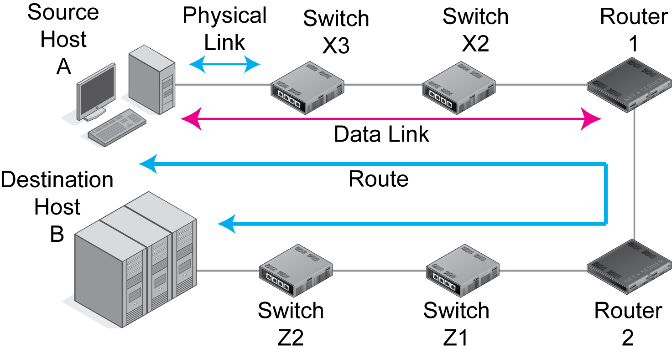
2.2: Physical, Data Link, and Internet Layers
Recap from Chapter 1
Notes:
Recap the three types of links.

Slide 7
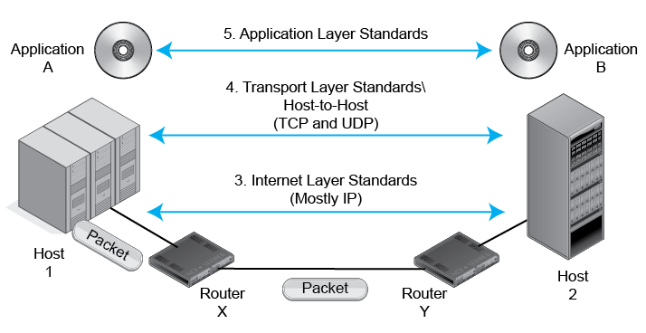
2.3: Internet, Transport and Application Layers
Recap from Chapter 1
Notes:
Recap the layers.

Slide 8
2.4: Layers
Recap from Chapter 1
Broad Function | Layer Number | Layer Name
Interoperability of application programs | 5 | Application
Transmission across an internet | 4 | Transport
 | 3 | Internet
Transmission across a single switched or wireless network | 2 | Data Link
 | 1 | Physical
Notes:
Recap this figure, describing how the layers are interrelated.

Slide 9
Chapter 2: Network Standards
Definitions and concepts
Message ordering and reliability
Semantics and syntax
Encoding application messages
Vertical communication on the source host
Standards architectures

Slide 10
2.5: Network Standards Concepts
Message Order
Turn taking (think of telephone conversations)
Order of messages in a complex transaction
Who must initiate communication, and so on
Reliability
A reliable protocol both detects and corrects errors during transmission.
Error detection alone is not enough.
Some unreliable protocols detect errors but then drop only incorrect messages.
Notes:
Read the text.
Give emphasis.

Slide 11
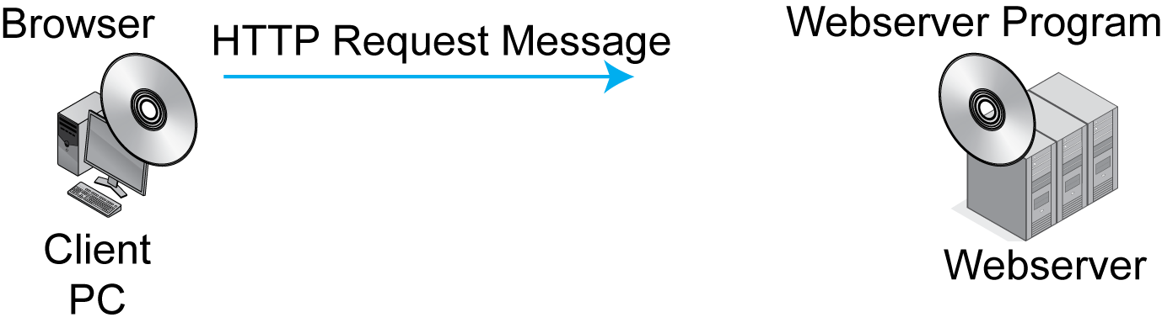
2.5: Network Standards Concepts
Message Order in HTTP
In HTTP, the client program initiates the communication by sending an HTTP request message.
Notes:
Read the text.
Then go through the illustration.

Slide 12
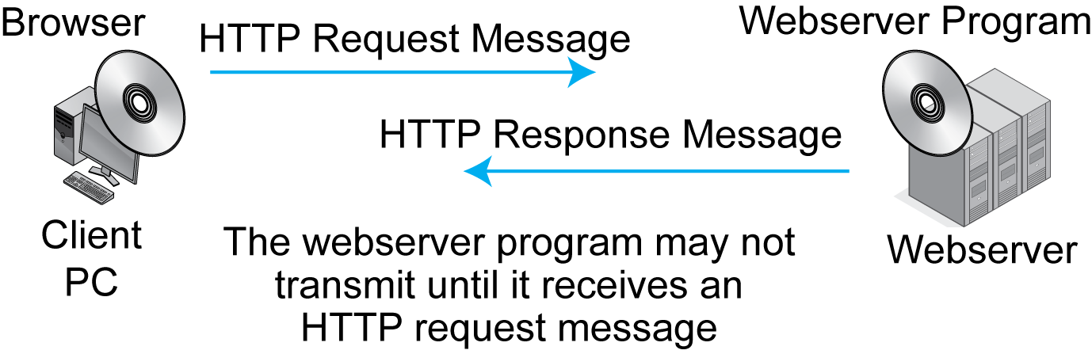
2.5: Network Standards Concepts
Message Order in HTTP
Notes:
Go through the illustration from left to right.

Slide 13
2.5: Network Standards Concepts
Reflection: Message Order in HTTP
The client must initiate the interaction.
Other network standards have more complex turn taking; for instance TCP.
Human turn taking is loose and flexible.
But message order for network standards must be rigid because computers are not intelligent.
TCP exemplifies more complex message ordering.
Notes:
Read the text.

Slide 14
2.7: A Connection
HTTP is connectionless.
Every request–response cycle is independent.
TCP is connection-oriented.
There is a formal opening of the connection.
Within the connection, messages are sequenced, acknowledged, and retransmitted if necessary.
There is a formal closing of the connection.
Notes:
Read the text.

Slide 15
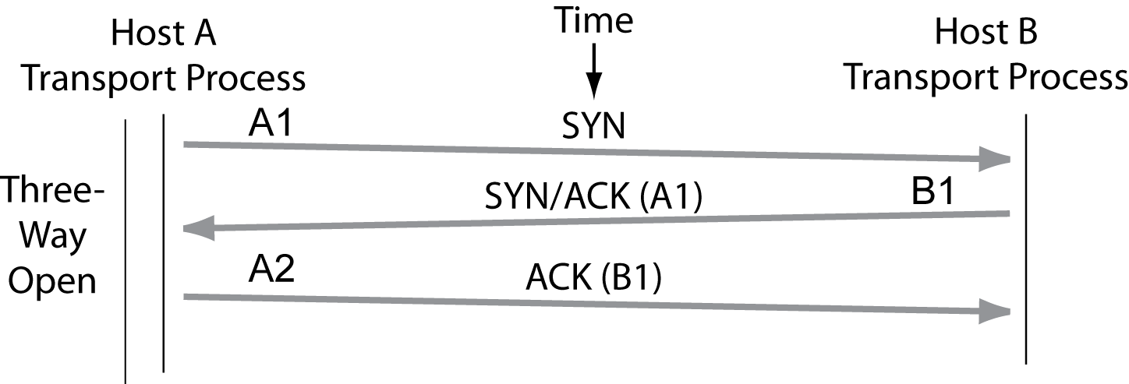
2.7: A TCP Connection
A connection opening requires three segments.
SYN segments have only headers with the SYN bit set.
Notes:
Go through the figure.

Slide 16
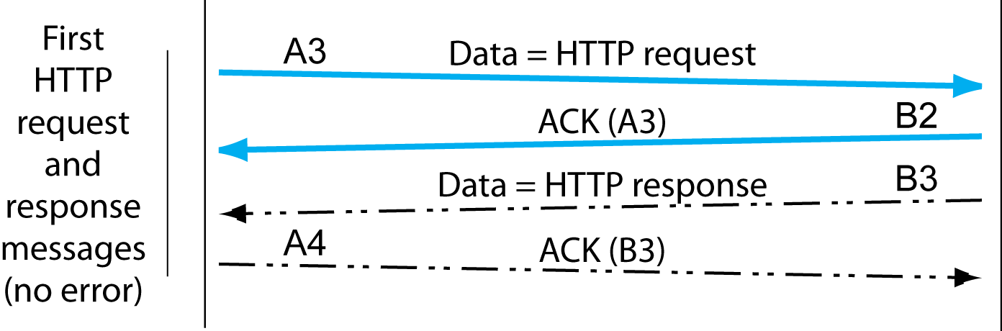
2.7: A TCP Connection
HTTP request and response messages are acknowledged if received correctly.
Notes:
Go through the figure top to bottom.

Slide 17
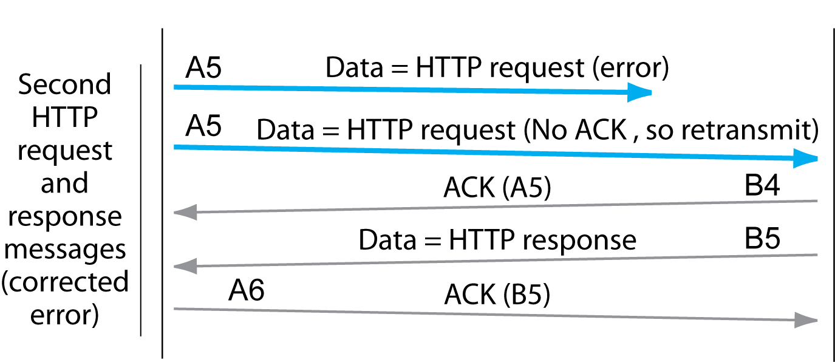
2.7: A TCP Connection
Unacknowledged segments are retransmitted.
Notes:
Go through the figure top to bottom.

Slide 18
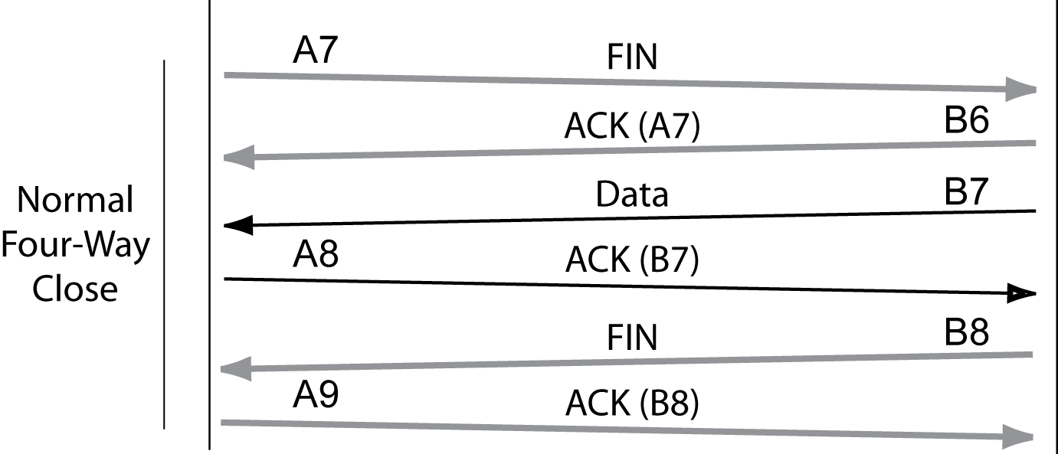
2.7: A TCP Connection
Four messages close connections
FIN segments are headers with the FIN bit set.
Notes:
Go through the figure top to bottom.

Slide 19
Chapter 2: Network Standards
Definitions and concepts
Message ordering and reliability
Semantics and syntax
Encoding application messages
Vertical communication on the source host
Standards architectures

Slide 20

2.5: Network Standards Concepts
Message Semantics
Semantics is the meaning of a message.
HTTP request message: “Please give me this file.”
HTTP response message: “Here is the file. (Or, I could not comply for the following reason …)”
Notes:
Read the text.

Slide 21
2.5: Network Standards Concepts
Message Semantics
Network standards normally have a very limited set of possible message meanings.
For example, HTTP requests have only a few possible meanings.
GET: Please give me a file.
PUT: Store this file (not often used).
A few more.
Notes:
Read the text.

Slide 22
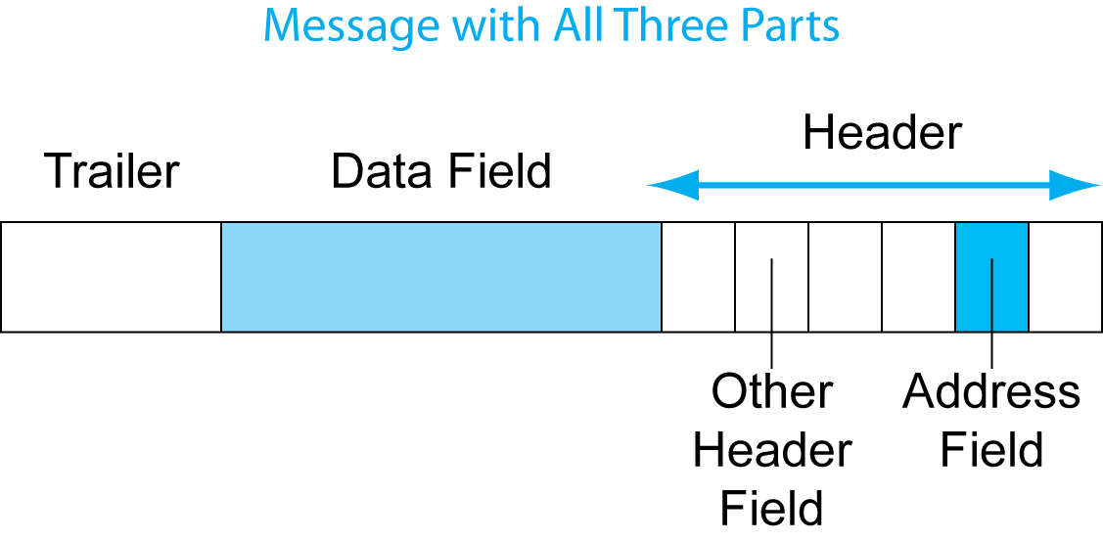
2.8: General Message Organization
Message Syntax: Message Layout
Like human grammar, but more rigid.
In general, messages may have three parts.
Notes:
Read the text.
Go through the three parts.
Emphasize that this is something that students will see throughout the book.

Slide 23
2.8: General Message Organization
Message Syntax
The data field contains the content being delivered.
The header is everything before the data field.
The trailer is everything after the data field.
Notes:
Read the text.
Note how simple the definitions of the header and trailer are.
Go through the illustration.

Slide 24
2.8: General Message Organization
Message Syntax
The header is usually broken into smaller sections called header fields.
There often is an address field to indicate where to deliver the message.
Notes:
Read the text.
Go through the illustration.

Slide 25
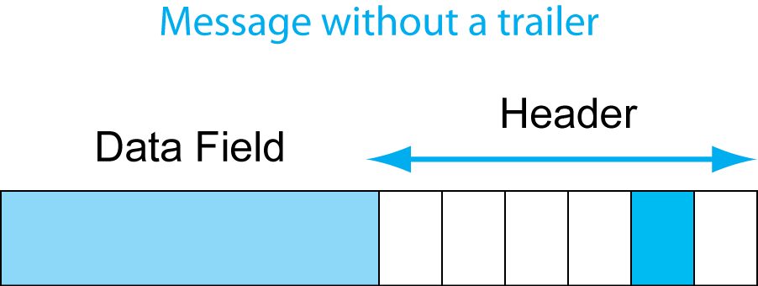
2.8: General Message Organization
Most Messages Do Not Have Trailers.
Notes:
Read the text.
Go through the illustration.

Slide 26
2.8: General Message Organization
Field lengths may be measured in
bits or bytes.
Another name for byte is “octet.”
The term “octet” is used frequently in networking.
Notes:
Read the text.
This is a simple but important concept.

Slide 27
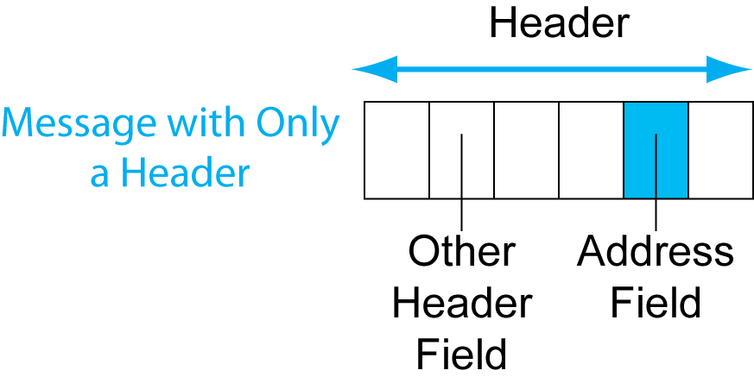
2.8: General Message Organization
Some messages do not have data fields.
Example: TCP SYN segments have only headers.
Notes:
Read the text.
Go over the illustration.

Slide 28
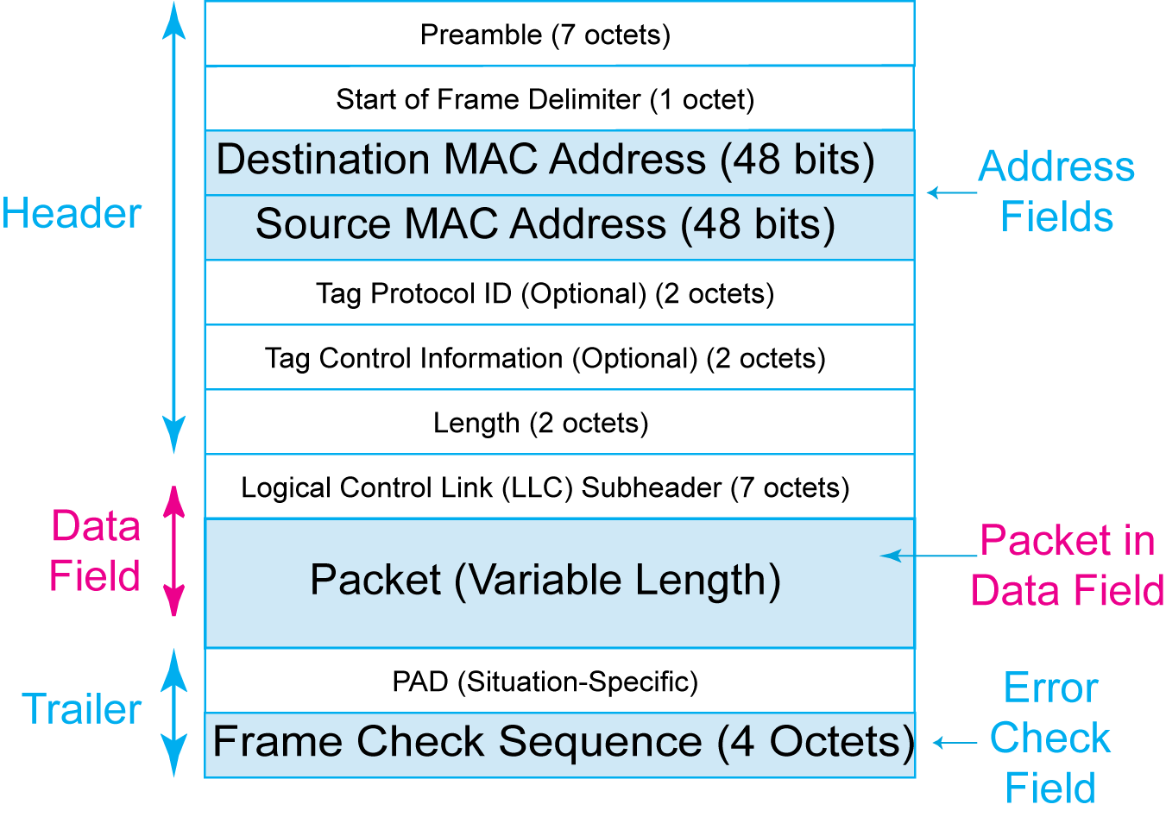
2.9: Ethernet Frame
The Ethernet frame has a header, data field, and trailer. The header has multiple fields.
Notes:
Read the text.
Go over the illustration.

Slide 29
2.9: Ethernet Frame
There are source and destination address fields.
Ethernet addresses are called MAC addresses
(We will see why in Chapter 5).
MAC addresses are 48 bits long.
(In contrast, IP addresses in IP packets are 32 bits long.)
Notes:
Read the text.
Go over the illustration.

Slide 30
2.9: Ethernet Frame
The Ethernet data field contains the packet that the frame is delivering.
Notes:
Read the text.
Go over the illustration.

Slide 31
2.9: Ethernet Frame
The trailer contains the
Frame Check Sequence field for error detection.
The sender computes the value based on all bits.
The receiver redoes the calculation.
If the receiver gets a different value,
it discards the frame.
There is no error correction.
Ethernet is not reliable.
Notes:
Read the text.
Go over the illustration.

Slide 32
2.10: IP Packet Organization
IP Version 4 (IPv4)
Dominant version of IP on the Internet today
32-bit IP addresses
More than 4 billion possible addresses
Handed out inefficiently, few available
IPv6
128-bit addresses should give an inexhaustible supply
New syntax for IP packets

Slide 33
2.10: IPv4 Packet Syntax
Bit 0 |  |  | Bit 31
Version Number (4 bits) | Header Length (4 bits) | Diff-Serv (8 bits) | Total Length (16 bits)
Identification (16 bits) |  |  | Flags (3 bits) | Fragment Offset (13 bits)
Time to Live (8 bits) |  | Protocol (8 bits) | Header Checksum (16 bits)
Source IP Address (32 bits)
Destination IP Address (32 bits)
Options (if any) |  |  |  |  | Padding (to 32-bit boundary)
Data Field (dozens, hundreds, or thousands of bits) Often contains a TCP segment
The IP packet is a long string of bits.
It is drawn 32 bits on each line.
The first line has the bits 0 through 31.
The second line has bits 32 to 63, and so on.
Notes:
Read the text.
Go over the illustration.

Slide 34
2.10: IPv4 Packet Syntax
Bit 0 |  |  | Bit 31
Version Number (4 bits) | Header Length (4 bits) | Diff-Serv (8 bits) | Total Length (16 bits)
Identification (16 bits) |  |  | Flags (3 bits) | Fragment Offset (13 bits)
Time to Live (8 bits) |  | Protocol (8 bits) | Header Checksum (16 bits)
Source IP Address (32 bits)
Destination IP Address (32 bits)
Options (if any) |  |  |  |  | Padding (to 32-bit boundary)
Data Field (dozens, hundreds, or thousands of bits) Often contains a TCP segment
For the Header Checksum field,
the sender calculates a number based on other bits
and places the number in the Header Checksum field.
The receiver redoes the calculation.
If the receiver does not get what the sender computed,
then there has been an error, and the packet is dropped.
Notes:
Read the text.
Go over the illustration.

Slide 35
2.10: IPv4 Packet Syntax
Bit 0 |  |  | Bit 31
Version Number (4 bits) | Header Length (4 bits) | Diff-Serv (8 bits) | Total Length (16 bits)
Identification (16 bits) |  |  | Flags (3 bits) | Fragment Offset (13 bits)
Time to Live (8 bits) |  | Protocol (8 bits) | Header Checksum (16 bits)
Source IP Address (32 bits)
Destination IP Address (32 bits)
Options (if any) |  |  |  |  | Padding (to 32-bit boundary)
Data Field (dozens, hundreds, or thousands of bits) Often contains a TCP segment
There are 32-bit fields for the
Source IP address and the Destination IP address.
Notes:
Read the text.
Go over the illustration.

Slide 36
2.10: IPv4 Packet Syntax
Bit 0 |  |  | Bit 31
Version Number (4 bits) | Header Length (4 bits) | Diff-Serv (8 bits) | Total Length (16 bits)
Identification (16 bits) |  |  | Flags (3 bits) | Fragment Offset (13 bits)
Time to Live (8 bits) |  | Protocol (8 bits) | Header Checksum (16 bits)
Source IP Address (32 bits)
Destination IP Address (32 bits)
Options (if any) |  |  |  |  | Padding (to 32-bit boundary)
Data Field (dozens, hundreds, or thousands of bits) Often contains a TCP segment
The data field often contains a TCP segment.
It may also contain a UDP datagram.
Notes:
Read the text.
Go over the illustration.

Slide 37
2.10: IPv6 Packet Syntax
Version
Traffic Class
Flow Label
Payload Length
Next Header
Hop Limit
Source Address (128 bits)
Destination Address (128 bits)
Optional Headers
Payload (Data Field)

Slide 38
2.10: Internet Protocol (IP) Packet
The IP packet always has a header.
The IP packet always has a data field.
The IP packet NEVER has a trailer.
In fact, trailers are found only on Layer 2 frames.
In fact, many Layer 2 frames do not have trailers.
Notes:
Read the text.

Slide 39
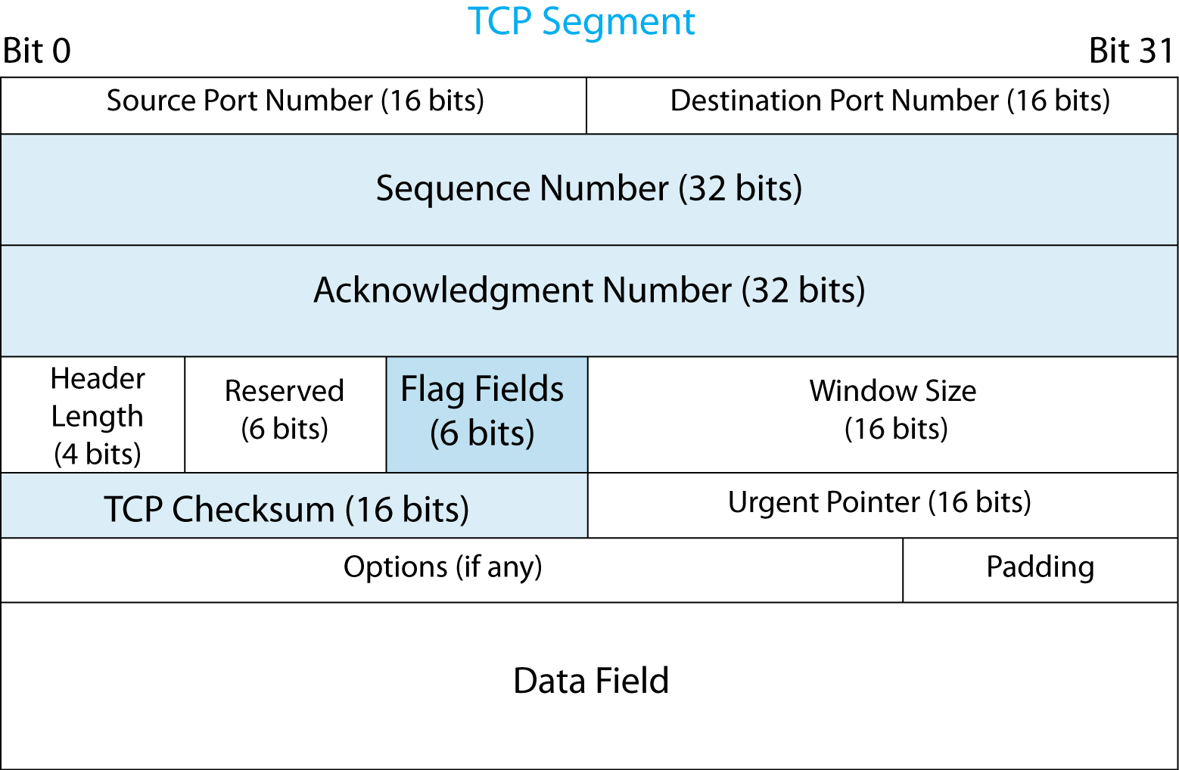
2.11: TCP Segment
The Sequence Number field gives the TCP segment’s order in the session.
The Acknowledgement Number field indicates which segment that this segment is acknowledging.
These fields are 32 bits long.
Notes:
Read the text.
Go over the illustration.

Slide 40
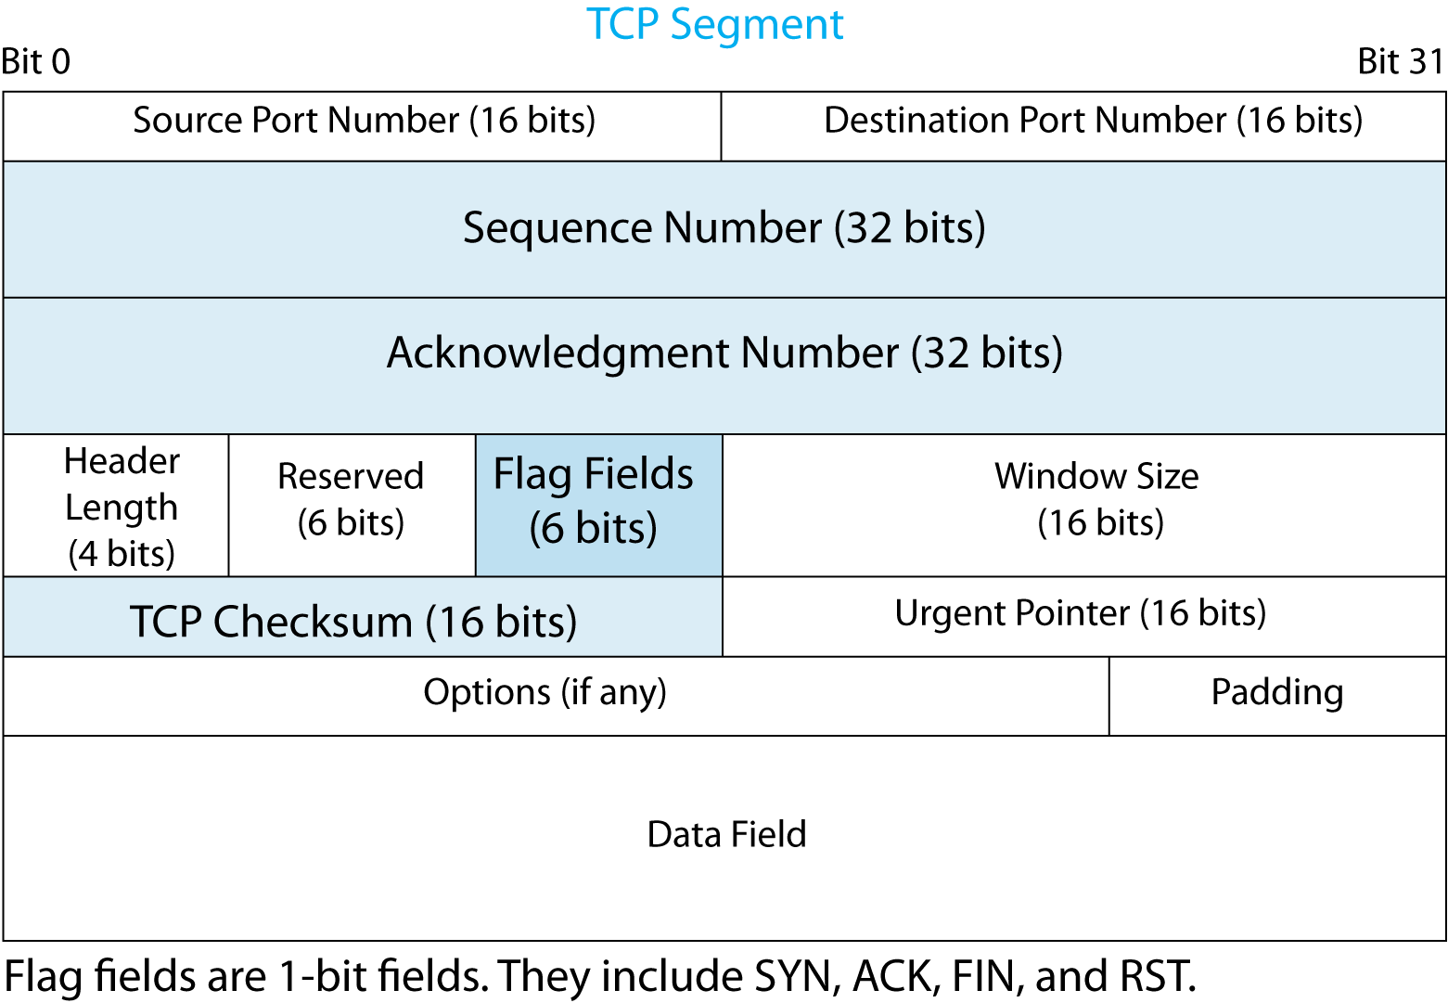
2.11: TCP Segment
Flag fields are one-bit fields.
If the value is 1, the flag field is Set.
If the value is 0, the flag field is Not Set.
Flag bits are SYN, ACK, FIN, and RST.
TCP has six flag fields.
Notes:
Read the text.
Go over the illustration.

Slide 41
2.11: TCP Segment
The TCP Checksum field is for error correction.
The sender computes the value in the field.
If the receiver computes the same value,
it sends an ACK.
If not, the receiver discards the segment and
sends nothing. The sender will resend the
segment. TCP is reliable.
Notes:
Read the text.
Go over the illustration.

Slide 42
2.11: TCP Segment
TCP segments always have headers.
SOME TCP segments do not have data fields.
Supervisory segments, such as SYN, do not carry data because the information to be conveyed, such as opening a connection, delivers no data.
TCP segments NEVER have trailers.
Notes:
Read the text.

Slide 43
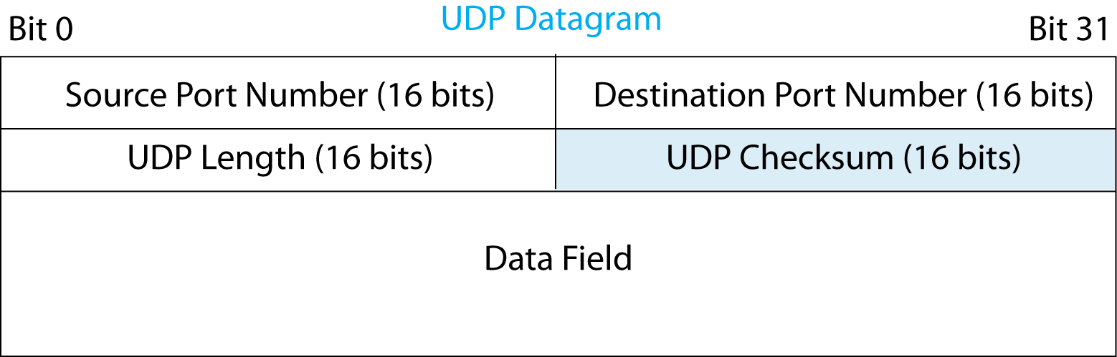
2.11: UDP Datagram
In UDP, the application message must fit into a single UDP datagram.
So, few header fields are needed.
The UDP Checksum field is for error detection.
If there is an error, UDP discards the datagram.
If it does not detect an error, it accepts the datagram but does not send an acknowledgement.
Notes:
Read the text.
Go over the illustration.

Slide 44
Perspective on TCP and UDP
If the transport layer process detects an error in an arriving TCP segment, what does it do?
If the transport layer process detects an error in an arriving UDP datagram, what does it do?
Are these actions different?
Notes:
It will drop the segment.
It will drop the segment.
No.

Slide 45
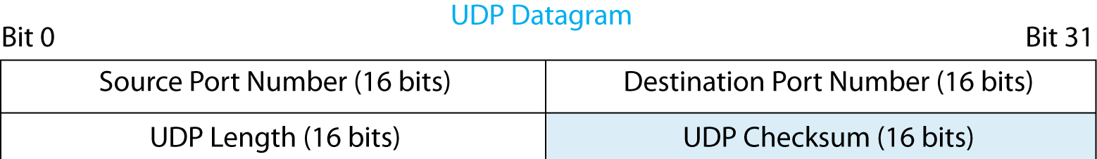
2.12: Recap: Port Number Fields
Both TCP and UDP headers begin with
a Source Port Number field and
a Destination Port Number field.
Notes:
Read the text.
Go over the illustration.

Slide 46
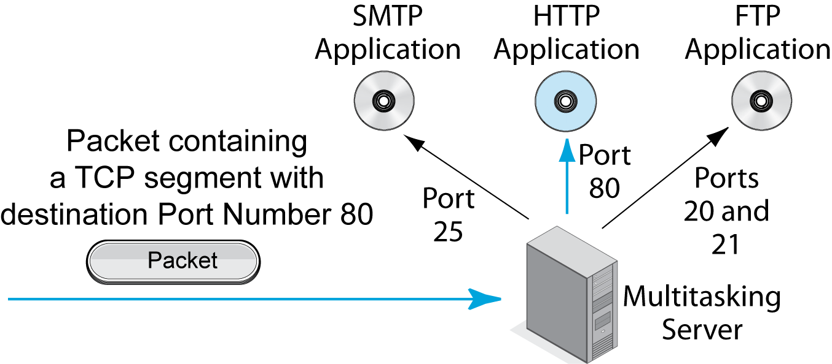
2.12: Port Numbers on Servers
Multitasking servers run multiple applications.
Each application is assigned a port number.
Notes:
Read the text.
Go over the illustration.

Slide 47
2.12: Port Numbers on Servers
Major applications usually are given
well-known port numbers from 0 to 1023.
HTTP’s well-known port number is 80.
The File Transfer Protocol has two: 20 and 21.
Notes:
Read the text.
Go over the illustration.

Slide 48

2.13: Hypertext Transfer Protocol Message Syntax
HTTP
The application layer is the highest layer.
It has more standards than any other layer.
HTTP is not the only application layer standard; it is one of many.
Many application layer protocols, such as SMTP for e-mail, are much more complex than HTTP.
Notes:
Read the text.
(Some students get hung up on HTTP as always being the application because it was used as the application in examples.)

Slide 49
2.13: Hypertext Transfer Protocol Message Syntax
HTTP Syntax Uses [CRLF]
This stands for carriage return plus line feed.
On printers, carriage moves the print head back to the left of the same line, and line feed moves the print head down a line.
In simpler terms, [CRLF] begins a new line.
Question: What will two [CRLFs] in a row do?
Notes:
Read the text.
Wave your hands a little to illustrate the concept.

Slide 50
2.13: Hypertext Transfer Protocol Message Syntax
HTTP Request Message:
GET /panko/home.htm HTTP/1.1[CRLF]
Host: voyager.shidler.hawaii.edu
In the first line:
GET says that this is a request to get a file.
/panko/home.htm is the location of the file.
HTTP/1.1 says that the browser speaks HTTP/1.1.
The second line specifies the host to receive this HTTP request message.
Notes:
Read the black-on-white text.
Then read the bubble text.

Slide 51
2.13: Hypertext Transfer Protocol Message Syntax
In HTTP, most lines have this syntax:
Keyword: Value
Example: Host: voyager.shidler.hawaii.edu
This is like e-mail, with its To:, From:, and so on, fields.
HTTP was based on e-mail header concepts.
Consequently, it feels old-fashioned.
Notes:
Read the text.

Slide 52
2.13: Hypertext Transfer Protocol Message Syntax
HTTP Response Message
HTTP/1.1 200 OK[CRLF]
Date: Tuesday, 20-MAR-2011 18:32:15 GMT[CRLF]
Server: name of server software[CRLF]
MIME-version: 1.0[CRLF]
Content-type: text/plain[CRLF]
[CRLF]
File to be downloaded. A string of bytes that may be text, graphics, sound, video, or other content.
Notes:
Read the text.
Go over MIME if you wish. Emphasize that it is a way of saying the type of file that is being delivered.
Two [CRLFs] in a row gives a blank line.

Slide 53
Perspective: Syntax
We have spent much time on message syntax because it is extremely important in networking.
Ethernet frames are drawn with fields one below the other.
IP, TCP, and UDP syntax are drawn with fields beginning with bit position.
HTTP header syntax is shown as a series of lines of text, most of which have the Keyword: Value format.
Notes:
Read the text.
This is a key figure in getting students to keep straight what they have been learning.

Slide 54
Chapter 2: Network Standards
Definitions and concepts
Message ordering and reliability
Semantics and syntax
Encoding application messages
Vertical communication on the source host
Standards architectures

Slide 55
2.14: Encoding Application Messages
Encoding
Applications must convert application message content into bits.
This is necessary because all lower layers have fields consisting only of ones and zeros.
This is called encoding.
11010001010
Notes:
Read the text.
Go over the illustration.

Slide 56
Encoding Text
Text often is encoded with 7-bit ASCII.
The eighth bit in each byte is unused.
Category | Character | ASCII Code | 8th bit
Uppercase letters | A | 1000001 | Unused
Lowercase letters | a | 1100001 | Unused
Digits (0–9) | 3 | 0110011 | Unused
Punctuation | Period | 0101110 | Unused
Punctuation | Space | 0100000
Control codes | Carriage return | 0001101 | Unused
Control codes | Line feed | 0001010 | Unused
Notes:
Read the text.
Go over the illustration.

Slide 57


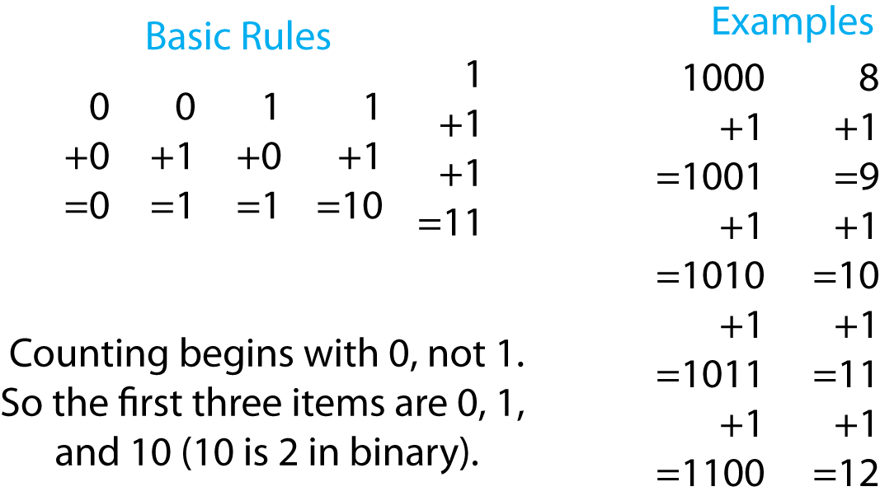
2.15: Binary Representations of Whole Numbers
Notes:
Go over the basic rules, then the details.
Note that counting begins with 0, not 1.
There are 10 types of people in this world—
those that count in binary and all others.

Slide 58
Chapter 2: Network Standards
Definitions and concepts
Message ordering and reliability
Semantics and syntax
Encoding application messages
Vertical communication on the source host
Standards architectures
Notes:
(Note: this is very difficult for students. I’ve cut it down in this edition.)

Slide 59
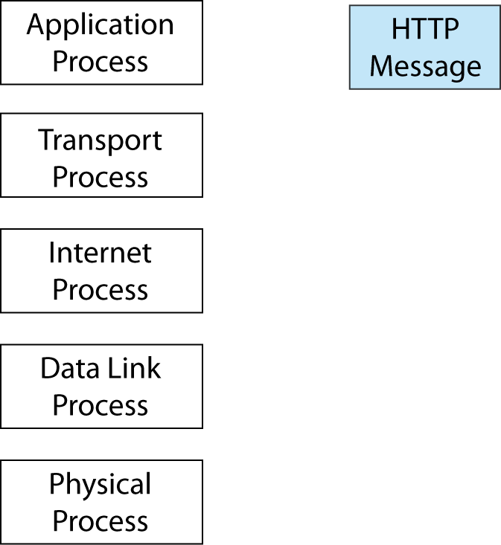
2.17: Source Host
The application process creates an application message for the application process on the destination host.
In this case, the application process is a browser.
Notes:
Go through the details.

Slide 60
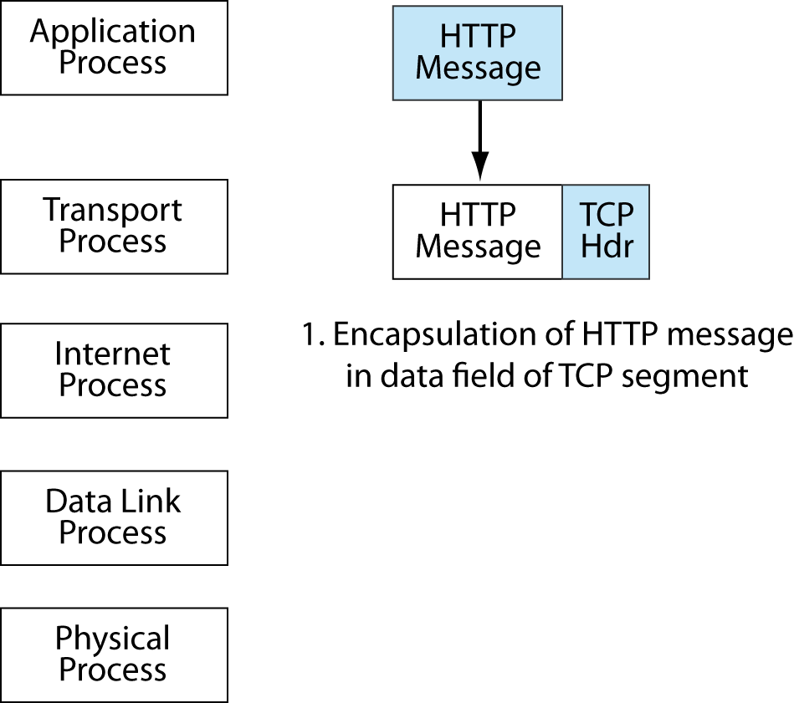
2.17: Source Host
The application process passes the HTTP message down to the transport layer process.
The transport process encapsulates the HTTP message in the data field of TCP segment.
This requires adding a TCP header.
Notes:
Read the text.
Then go through the details.

Slide 61
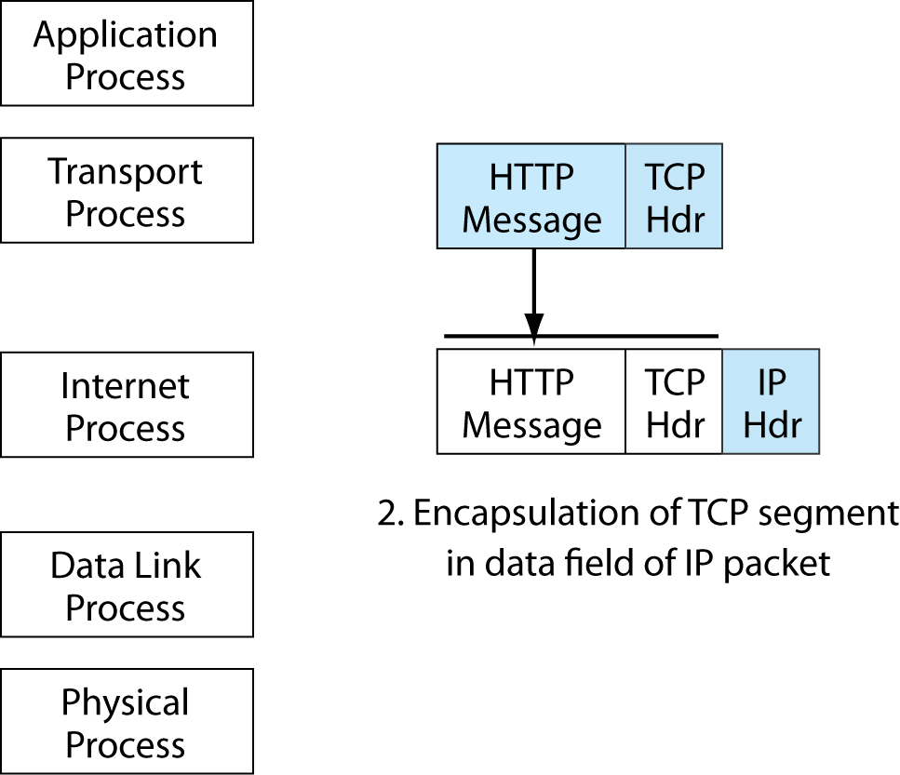
2.17: Source Host
The transport process passes the TCP segment down to the internet process, which encapsulates the segment in an IP packet.
Notes:
Read the text.
Then go through the details.

Slide 62
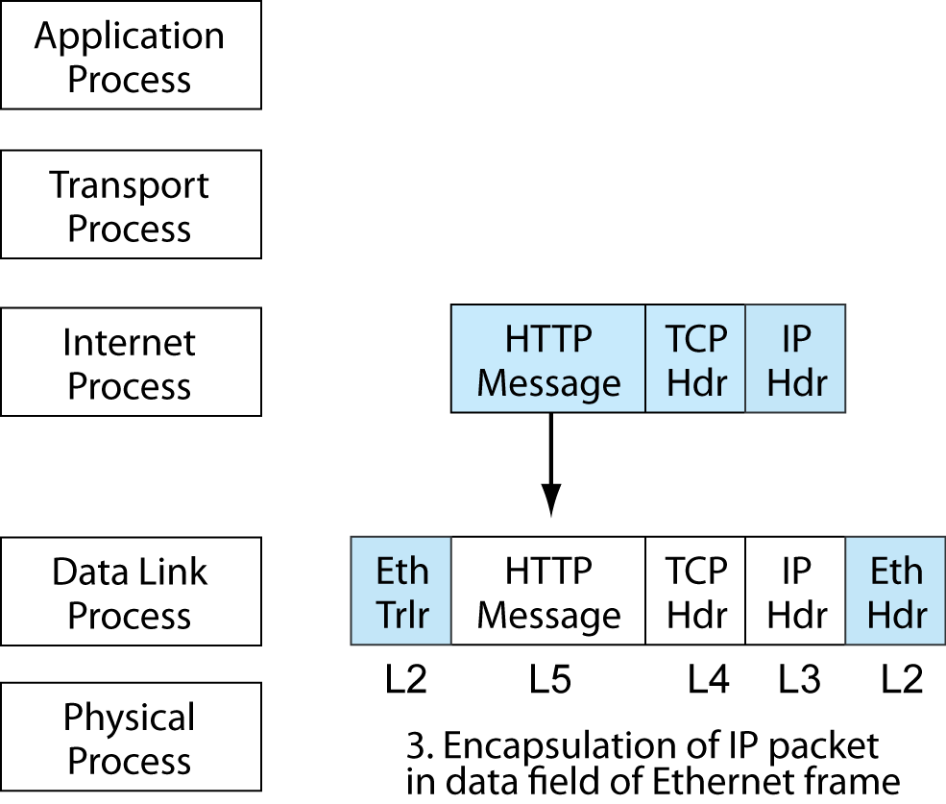
2.17: Source Host
The internet process passes the IP packet to the data link process, which is Ethernet.
Ethernet adds a header and trailer.
Notes:
Read the text.
Then go through the details.

Slide 63
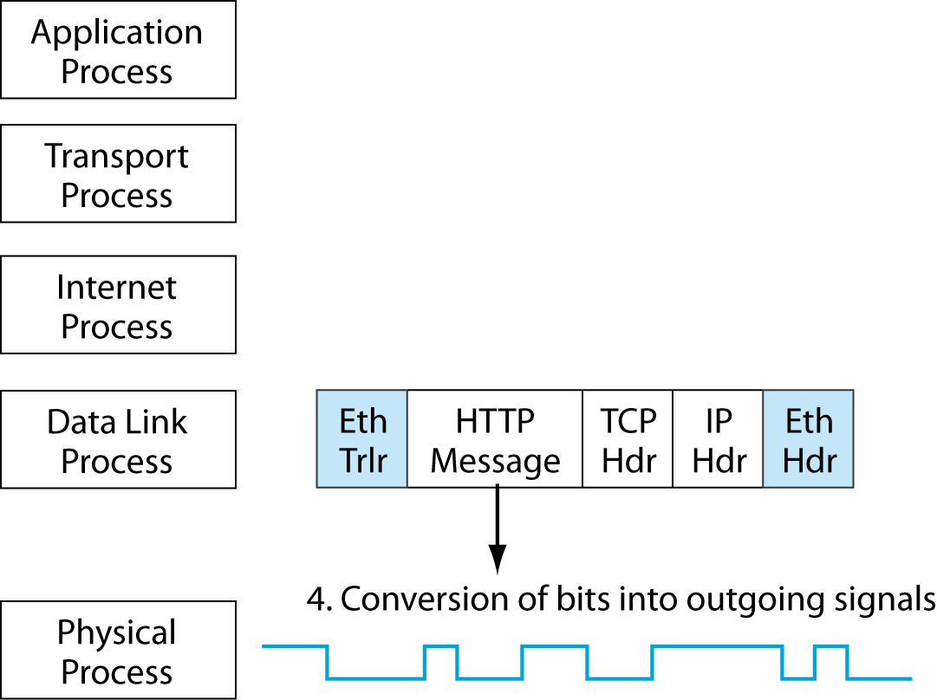
2.17: Source Host
The data link process passes the frame down to the physical layer.
The physical layer does NOT do encapsulation. It merely converts the bits of the frame into signals.
Notes:
Read the text.
Then go through the details.

Slide 64
2.17: Vertical Communication on the Source Host
The application, transport, internet, and data link layer process do the same thing.
Create a message in all but the originating layer (in this case, application) by encapsulation.
Then pass the message down to the next lower layer.
The physical layer process is different.
It merely converts the bits of the frame into signals.
Notes:
Read the text.

Slide 65
Chapter 2: Network Standards
Definitions and concepts
Message ordering and reliability
Semantics and syntax
Encoding application messages
Vertical communication on the source host
Standards architectures

Slide 66
Major Standards Architectures
There are two major standards architectures.
TCP/IP
This is the standards architecture for the Internet and many corporate internets.
Its standards agency is the Internet Engineering Task Force (IETF).
As we saw in Chapter 1, most of its documents are called requests for comment (RFCs).
Some (but not all) RFCs are official Internet standards.
Notes:
Read the text.

Slide 67

Major Standards Architectures
OSI
Its two standards agency are ISO and the ITU-T.
ISO (the International Organization for Standardization) is a computer standards agency.
The ITU-T is the International Telecommunications Union—Transmission Standards Agency.
Don’t confuse ISO the organization with OSI the architecture.
Notes:
Read the text.

Slide 68
Major Standards Architectures
OSI divides standards into seven layers:
Broad Purpose | OSI Layers
Application communication | Application (Layer 7)
 | Presentation (Layer 6)
 | Session (Layer 5)
Internetworking | Transport (Layer 4)
 | Network (Layer 3)
Communications within a single LAN or WAN | Data Link (Layer 2)
 | Physical (Layer 1)
Notes:
Go through the figure.

Slide 69

Major Standards Architectures
OSI divided application communication into three layers (Figure 2.20).
Session (5) creates a managed session between applications. If there is a break in communication, the communication has only to go back to the last roll-back point.
Presentation (6) was designed to translate between data formats on different computers. In practice, it is used as a category for file format standards, such as jpg and mp3.
Application (7) handles other details of application communication.
Notes:
Read the text.

Slide 70
Major Standards Architectures
TCP/IP divides standards into four layers.
Broad Purpose | TCP/IP
Applications | Application
Internetworking | Transport
 | Internet
Communication within a single LAN or WAN | The IETF assumes that OSI standards will be used at the Physical and Data Link Layers
Notes:
Go through the figure.

Slide 71
Hybrid TCP/IP-OSI Standards Architecture
Companies actually use the Hybrid TCP/IP-OSI Standards Architecture that takes standards at different layers from the two architectures.
Layer | Name | Source
5 | Application | TCP, OSI, and others
4 | Transport | TCP/IP (TCP and UDP)
3 | Internet | TCP/IP (IP)
2 | Data Link | OSI (Ethernet)
1 | Physical | OSI (Ethernet)
Notes:
Go through the details.
This is really really really important.

Slide 72
Major Standards Architectures
Dominance
OSI is dominant at the physical and data link layers.
It is so dominant that the IETF assumes that network users will use OSI standards at the physical and data link layers.
This means single switched or wireless LANs and WANs.
Notes:
Read the text.

Slide 73
Major Standards Architectures
Dominance
TCP/IP is dominant at the internet and transport layers.
These layers govern internetworking.
Notes:
Read the text.

Slide 74
Major Standards Architectures
Dominance
At the application layer, many standards come from TCP/IP, but many also come from OSI, the World Wide Web Consortium, and other standards agencies.
Notes:
Read the text.

Slide 75
2.21 Recap: Characteristics of Protocols in this Chapter
Layer | Protocol | Connection-Oriented or Connectionless? | Reliable or Unreliable
5 (Application) | HTTP | Connectionless | Unreliable
4 (Transport) | TCP | Connection-Oriented | Reliable
4 (Transport) | UDP | Connectionless | Unreliable
3 (Internet) | IP | Connectionless | Unreliable
2 (Data Link) | Ethernet | Connectionless | Unreliable
Notes:
Go through the details.

Slide 76
Chapter 2: Network Standards
Definitions and concepts
Message ordering
Semantics and syntax
Encoding application messages
Vertical Communication on the source host
Standards architectures

Slide 77
Where We Go Next
Chapter 1: Core concepts and principles
Chapter 2: Standards concepts
Chapter 3: Network Security
Security is now central to networking, consuming a great deal of network resources.
Security failures can be catastrophic.
We will look at threats and the plan-protect-respond cycle that companies use to respond to threats.
Notes:
Read the text.

